Slide 1
GROCERY SHOPPING WEBSITE APPLICATION
TEAM MEMBERS(BATCH NO:19)
Tamilselvan.S (211521205166)
Thiruvenkatam.V (211521205170)
Ruthresh.V (211521205125)
Sanjay kumar.P (211521205134)

Slide 2
ABSTRACT:
The Grocery Shopping Website Application is designed to enhance the shopping experience by providing a user-friendly platform that simplifies the process of purchasing groceries online.
This application offers a comprehensive catalog of products, allowing users to browse, search, and filter items based on their preferences and dietary needs. With features such a personalizere commendations, shopping lists, and easy reordering.
The application also integrates secure payment options and delivery scheduling to ensure convenience and reliability.

Slide 3
INTRODUCTION:
In today's fast-paced world, convenience and efficiency are essential in our daily lives, especially when it comes to grocery shopping. FreshMart is designed to make your shopping experience seamless, enjoyable, and hassle-free.
Our user-friendly platform allows you to browse a wide variety of fresh produce, pantry essentials, and household items from the comfort of your home.With just a few clicks, you can access quality products, exclusive deals, and personalized recommendations tailored to your preferences.
Our commitment to sustainability and local sourcing ensures that you receive the freshest ingredients while supporting local farmers and producers

Slide 4
PROPOSED SYSTEM:
Browse and Search: Customers can explore a wide variety of grocery items, including fresh produce, packaged foods, and household essentials, using category-based browsing and advanced search filters.
Shopping Cart and Wishlist: Users can add products to a shopping cart for immediate purchase or save them in a wishlist for future reference.
User Accounts and Personalization: Registered users will have personalized accounts where they can view previous orders, track current orders, receive tailored product recommendations, and set delivery preferences.
Multiple Payment and Delivery Options: The application will support a range of payment gateways and allow customers to select convenient delivery or pickup options, ensuring flexibility.

Slide 5
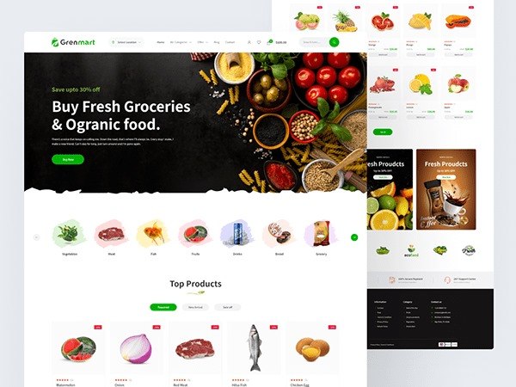
WEBSITE:

Slide 6
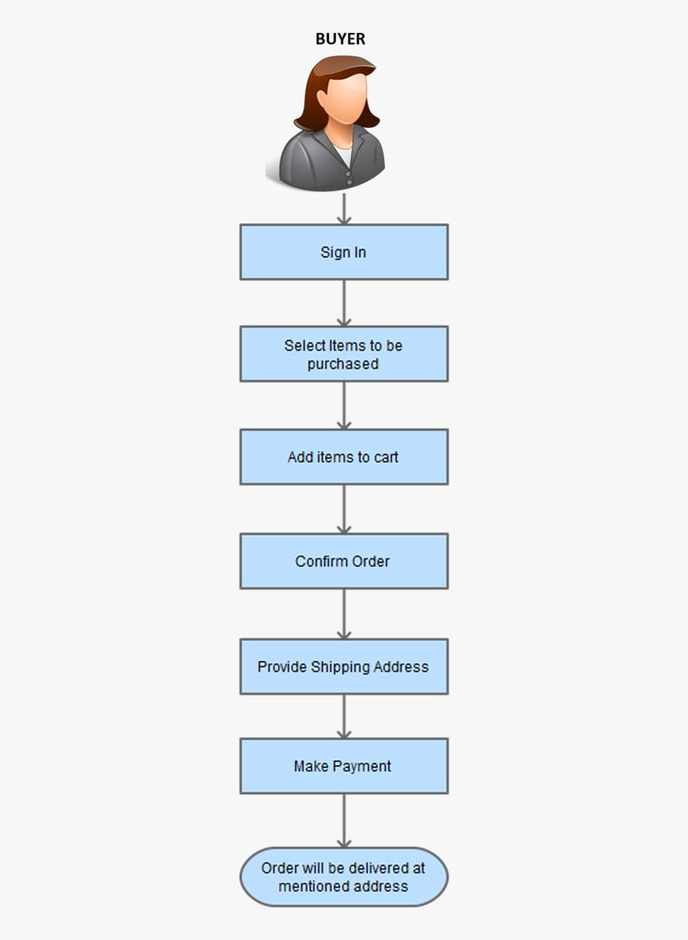
FLOWCHART:

Slide 7
CONCLUSION:
In conclusion, a grocery shopping web application provides a modern, efficient solution to the challenges of traditional grocery shopping. By offering a platform where users can browse, purchase, and receive their groceries with easy, it enhances convenience and saves time

Slide 8
THANK YOU

